Slide 1
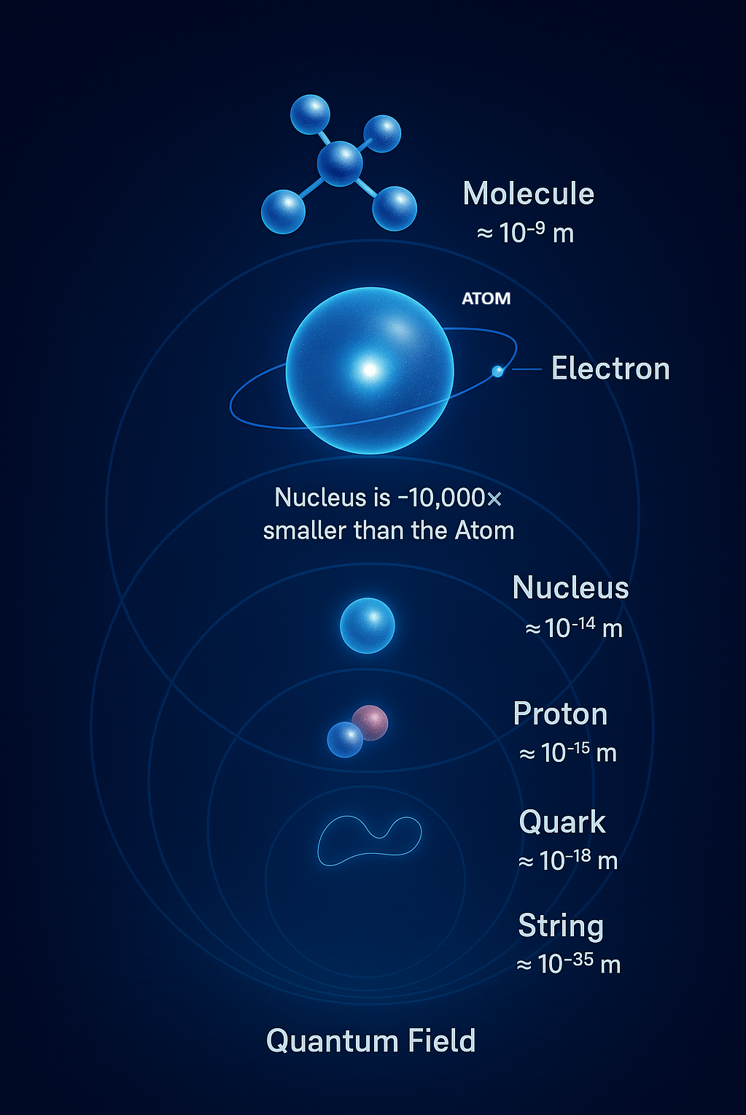
Journey into the Quantum World with Imagination and Knowledge
Welcome to an incredible adventure into the hidden world of atoms, particles, and quantum mysteries. Get ready to discover how the tiniest building blocks of reality work in ways that challenge everything we think we know about the universe.

Slide 2
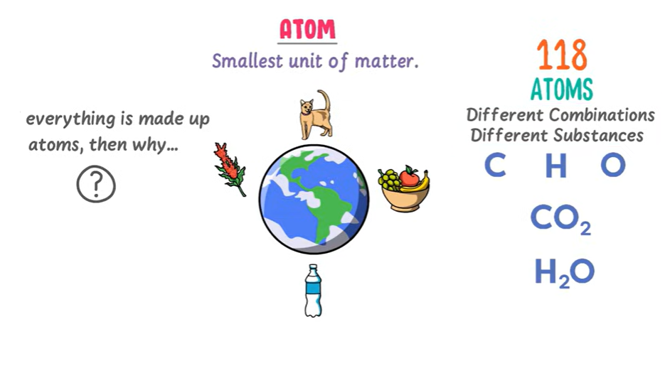
What is the Difference Between ATOM MOLECULES ELEMENT COMPUND

Slide 3
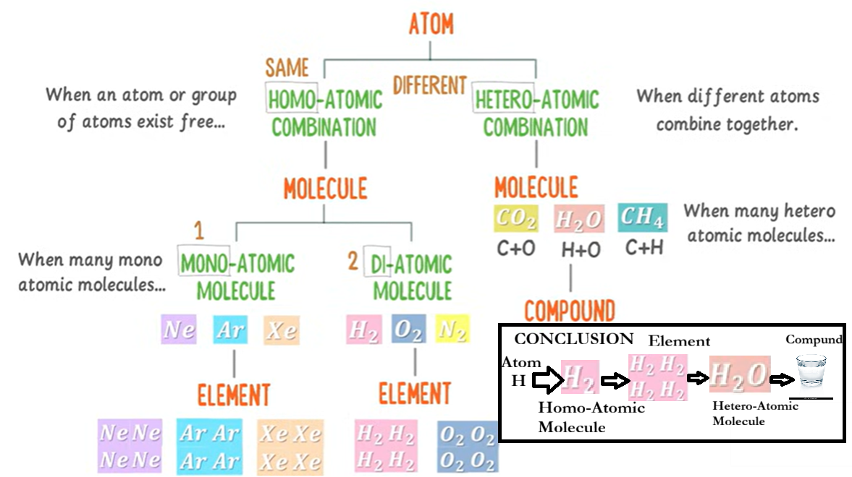
The Building Blocks of Everything

Slide 4
QUANTUM BIOLOGY
Glucose (C₆H₁₂O₆) → Glycolysis → Pyruvate → Krebs Cycle → NADH/FADH₂ → Electron Transport Chain → ATP
Quantum Biology — The Foundation
Quantum biology studies how quantum phenomena (like superposition, tunneling, and entanglement) play a role in biological processes — things that classical physics alone can’t fully explain.
. Glucose Breakdown and Cellular Energy
Glucose (C₆H₁₂O₆) enters the cell.
Through glycolysis, it splits into two C₃ molecules called pyruvates.
These pyruvates enter the mitochondria — the "powerhouse" of the cell.
Inside mitochondria:
The Krebs cycle (Citric Acid Cycle) converts pyruvate into high-energy molecules (NADH, FADH₂).
These feed electrons into the Electron Transport Chain (ETC), a sequence of five complex protein structures (C1–C5) embedded in the inner mitochondrial membrane.
3. Quantum Mechanics Inside Mitochondria
The ETC complexes (C1–C5) act like nano-electromechanical motors. Each complex transfers electrons and protons with quantum precision — often involving quantum tunneling of electrons.
ATP synthase (at the end of the chain) rotates at 6000–9000 RPM, converting proton flow into chemical energy (ATP).
Protons (H⁺) combine with oxygen (O₂) to form water (H₂O) — completing the cycle.
Result: This quantum-level energy transformation produces ATP, which powers RNA, DNA synthesis, and all human cellular functions.

Slide 5
4. Quantum Phenomena in Biology
Quantum tunneling: Electrons (or even protons) jump across energy barriers — essential in enzyme reactions and respiration.
Quantum coherence: Found in photosynthesis and possibly in mitochondrial electron transfer — allowing near-perfect energy efficiency.
Quantum entanglement: Proposed in processes like magnetoreception (how birds navigate using Earth's magnetic field).
5. Quantum Communication in Nature
Humans currently rely on electromagnetic communication (radio, optical, etc.). However, biological systems might use chemical or quantum communication — signaling through wave-particle duality (thought waves, molecular vibrations, etc.).
Thought waves or biofields can be viewed as matter-energy interactions at the quantum level.
6. Sun, Neutrinos, and Quantum Tunneling
The Sun emits neutrinos, extremely tiny particles that pass through our bodies and Earth almost undisturbed. This is an example of quantum tunneling — they can cross barriers of dense matter as if slipping through.
Such particles might subtly influence biological or quantum processes (still under theoretical exploration)
8. Navigation and Quantum Sensing
Birds navigate using magnetoreception, which may rely on quantum entanglement in cryptochrome proteins in their eyes.
Similarly, spacecraft navigation and biological orientation might one day harness quantum-level sensing mechanisms.
7. Calcification and Cellular Quantum Effects
If calcium ions (Ca²⁺) fail to exit cells properly, it leads to calcification, affecting electrical and quantum communication in tissues.
Proper ion exchange is essential for quantum coherence in cell membranes and neural activity.

Slide 6
In Summary
Biological Process | Quantum Effect | Description
Glucose → ATP | Electron tunneling | Electrons move via quantum tunneling through C1–C5
ATP synthase | Quantum rotor | Nano-motor spinning at 6000–9000 RPM
Photosynthesis / Mitochondria | Quantum coherence | Efficient energy transfer
Bird navigation | Quantum entanglement | Magnetoreception based on spin pairs
Thought waves | Quantum field theory | Mind-matter energy interaction
Neutrinos from Sun | Quantum tunneling | Passing through matter at subatomic scale

Slide 7
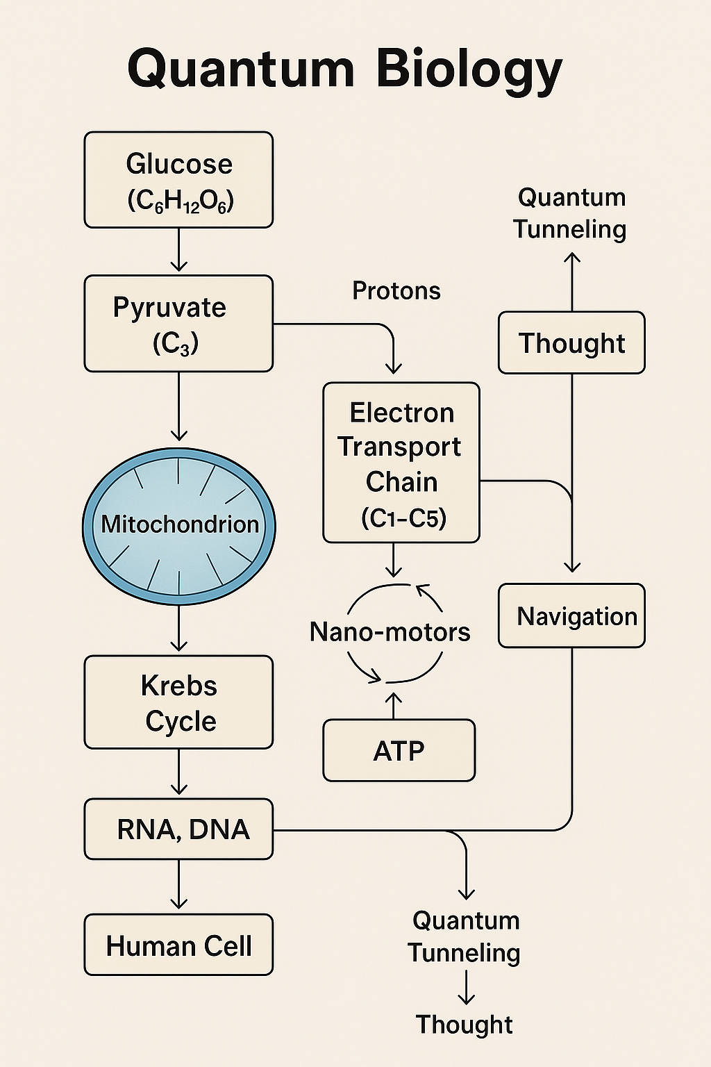

Slide 8
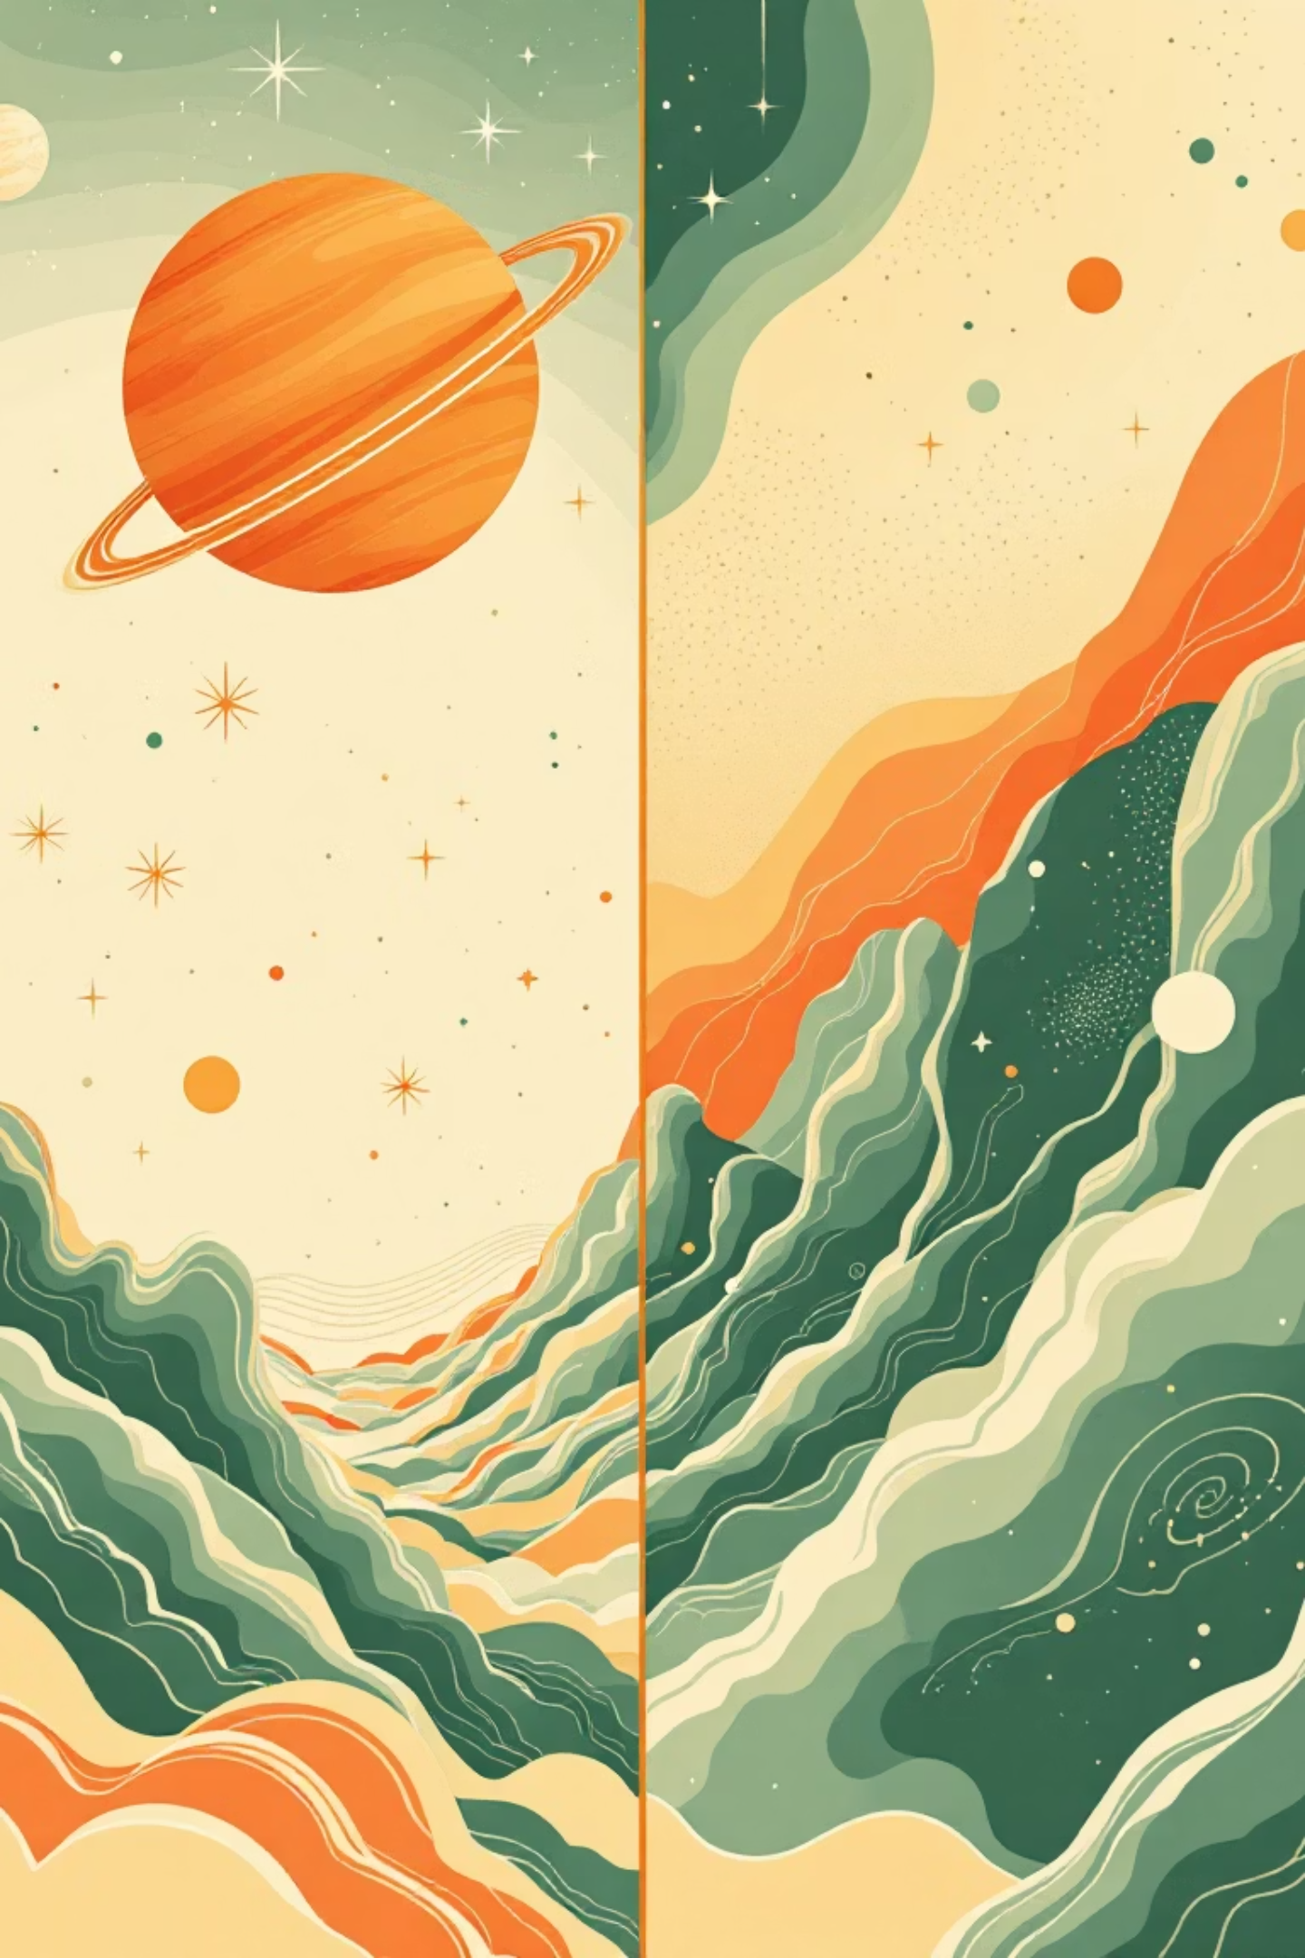
Two Revolutionary Ways to Understand Reality
Theory of Relativity
Quantum Physics
Einstein's domain: The very large and very fast
The realm of the tiny: Atoms and particles
Explains gravity, space, and time
Explains subatomic behavior
Rules electrons, photons, and quarks
Governs stars, planets, and galaxies
Deals with particles smaller than atoms
Deals with massive objects and cosmic speeds
Probabilistic and strange
Predictable and deterministic
Works perfectly for small things
Works perfectly for big things

Slide 9
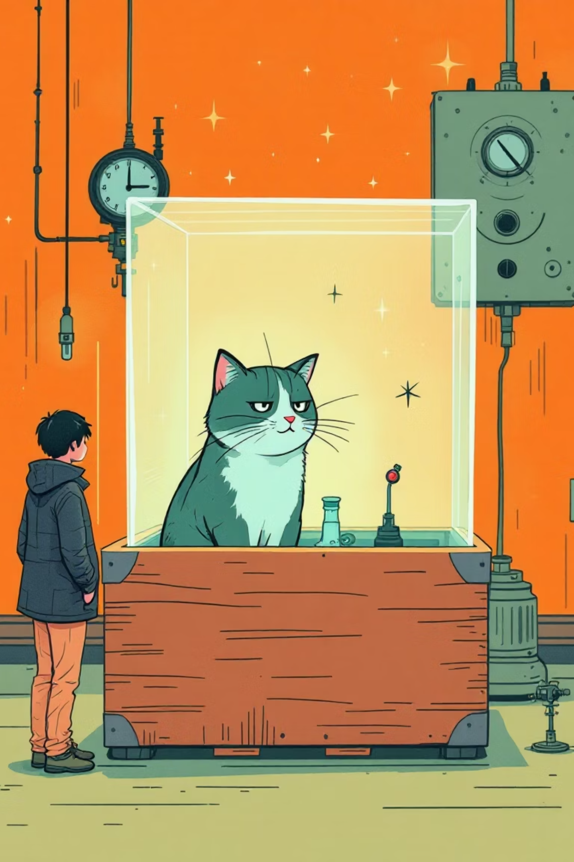
Schrödinger's Famous Cat
Imagine a cat in a sealed box with a device that has a 50% chance of releasing poison. Until you open the box and look, quantum physics says the cat is both alive and dead at the same time. This thought experiment shows how observation affects reality at the quantum level.
Before Opening
The cat exists in superposition—simultaneously alive and dead until observed.
After Opening
The moment you observe, reality "chooses" one outcome. The cat is either alive or dead.
This bizarre principle reveals that at quantum scales, particles exist in multiple states until measured. Observation literally changes reality!

Slide 10


Atoms Are Mostly Empty Space
99.9999999% Empty
Here's a mind-bending fact: if an atom were the size of a football stadium, the nucleus would be smaller than a marble at the center. Everything else? Empty space.
If you could remove all the empty space from every atom in every person on Earth, the entire human race would fit into a volume the size of a sugar cube. If all atoms in the universe had their empty space removed, the entire cosmos could shrink to the size of a lemon!
We feel solid because of electromagnetic forces between atoms, not because matter itself is dense.

Slide 11

What Does "Quantum" Actually Mean?
The word "quantum" comes from Latin, meaning "how much" or a specific amount. In physics, it refers to the smallest possible discrete unit of any physical property.
Think of it like this: you can't have half a coin or 1.5 eggs. Similarly, energy, light, and other properties come in tiny, indivisible packets called quanta (plural of quantum).
Energy doesn't flow smoothly like water—it comes in tiny, specific chunks, like steps on a staircase rather than a ramp.

Slide 12
Quantum Physics Transforms Healthcare
MRI Scans
Cancer Treatment
Quantum Sensors
Magnetic Resonance Imaging uses quantum properties of atoms to create detailed images inside your body without surgery or radiation.
Quantum mechanics enables precise radiation therapy and PET scans that target tumors while minimizing damage to healthy tissue.
Ultra-sensitive quantum sensors detect diseases earlier by measuring tiny biological changes invisible to traditional instruments.

Slide 13
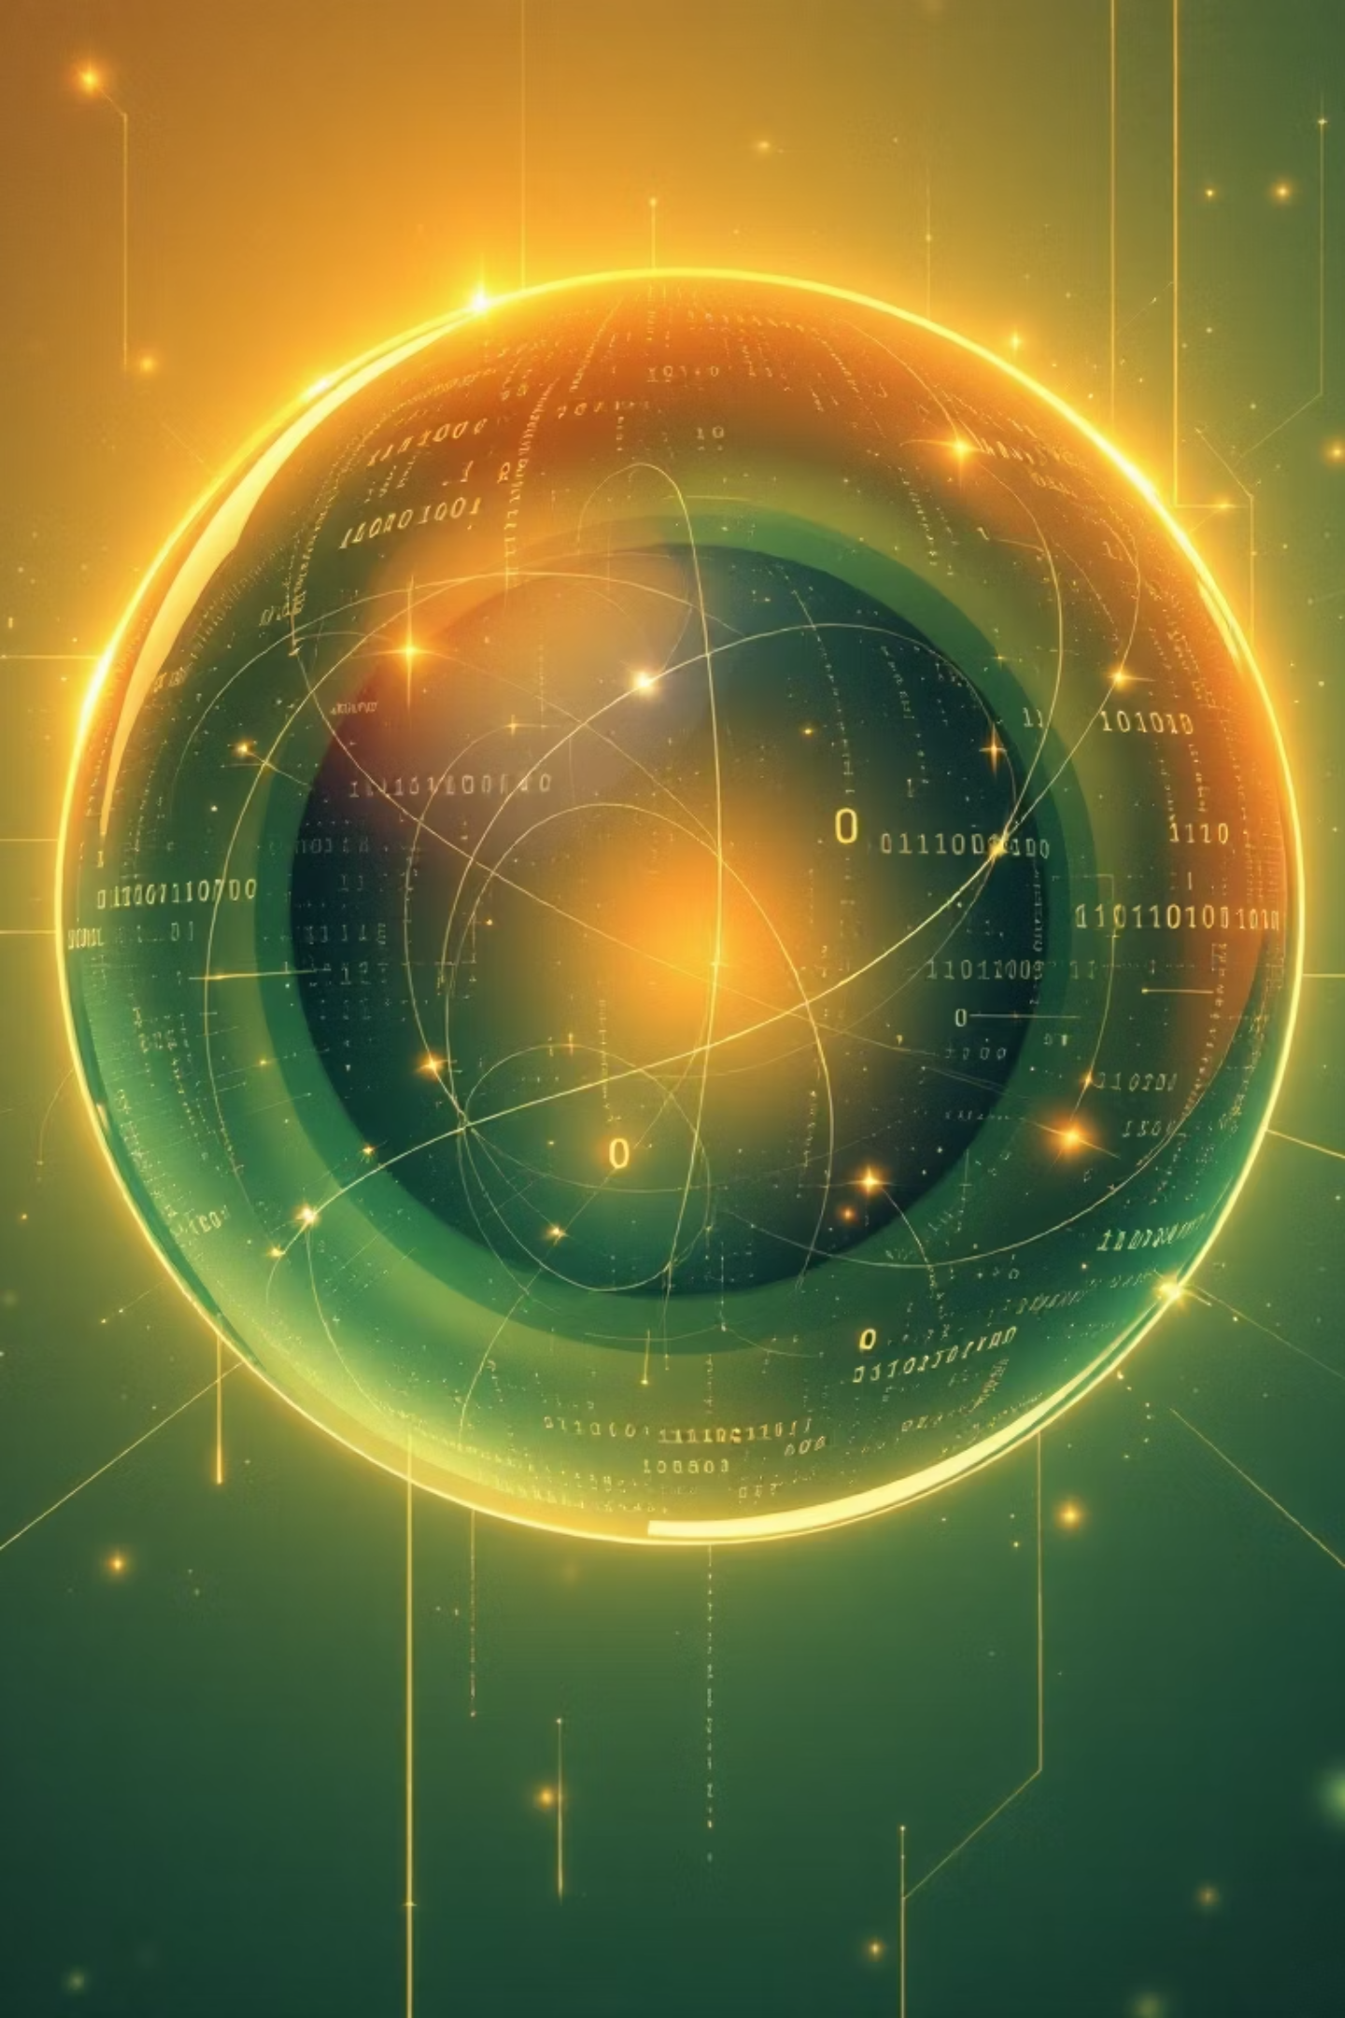
Meet the Qubit: Quantum's Game Changer
Classical Bit
Quantum Bit (Qubit)
Traditional computers use bits that are either:
Quantum computers use qubits that can be:
0 (off) or
0, 1, or
1 (on)
Both at the same time!
One state at a time, like a light switch.
This is called superposition.
This quantum property allows quantum computers to process massive amounts of information simultaneously, solving certain problems millions of times faster than traditional computers.

Slide 14
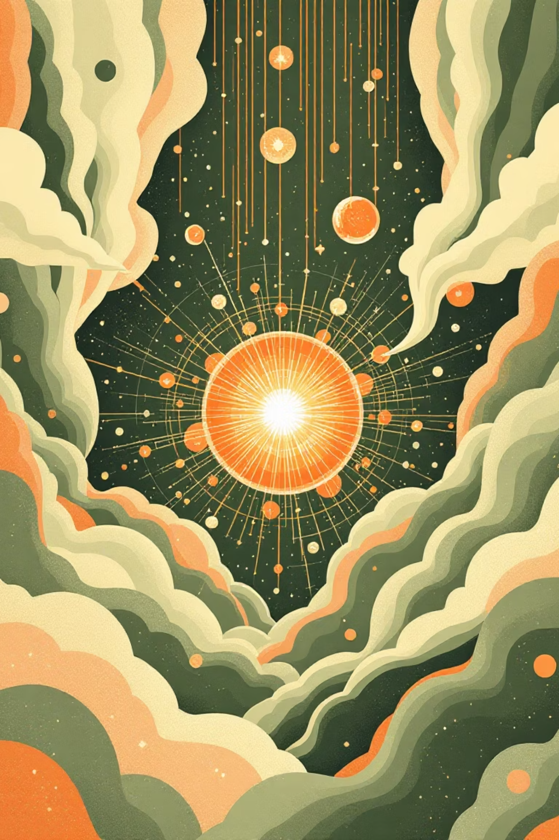
Superposition: Being Here and There
Classical World
A coin is either heads or tails. A light is either on or off. You're either here or there. Everything has one definite state.
Quantum World
A quantum particle can be in multiple states simultaneously until measured. It's like a spinning coin—both heads and tails at once—until it lands.
This isn't just theory. Scientists have proven that electrons, photons, and even molecules can exist in multiple places or states at the same time. Superposition is what gives quantum computers their incredible power—they can explore many solutions simultaneously instead of checking them one by one.

Slide 15
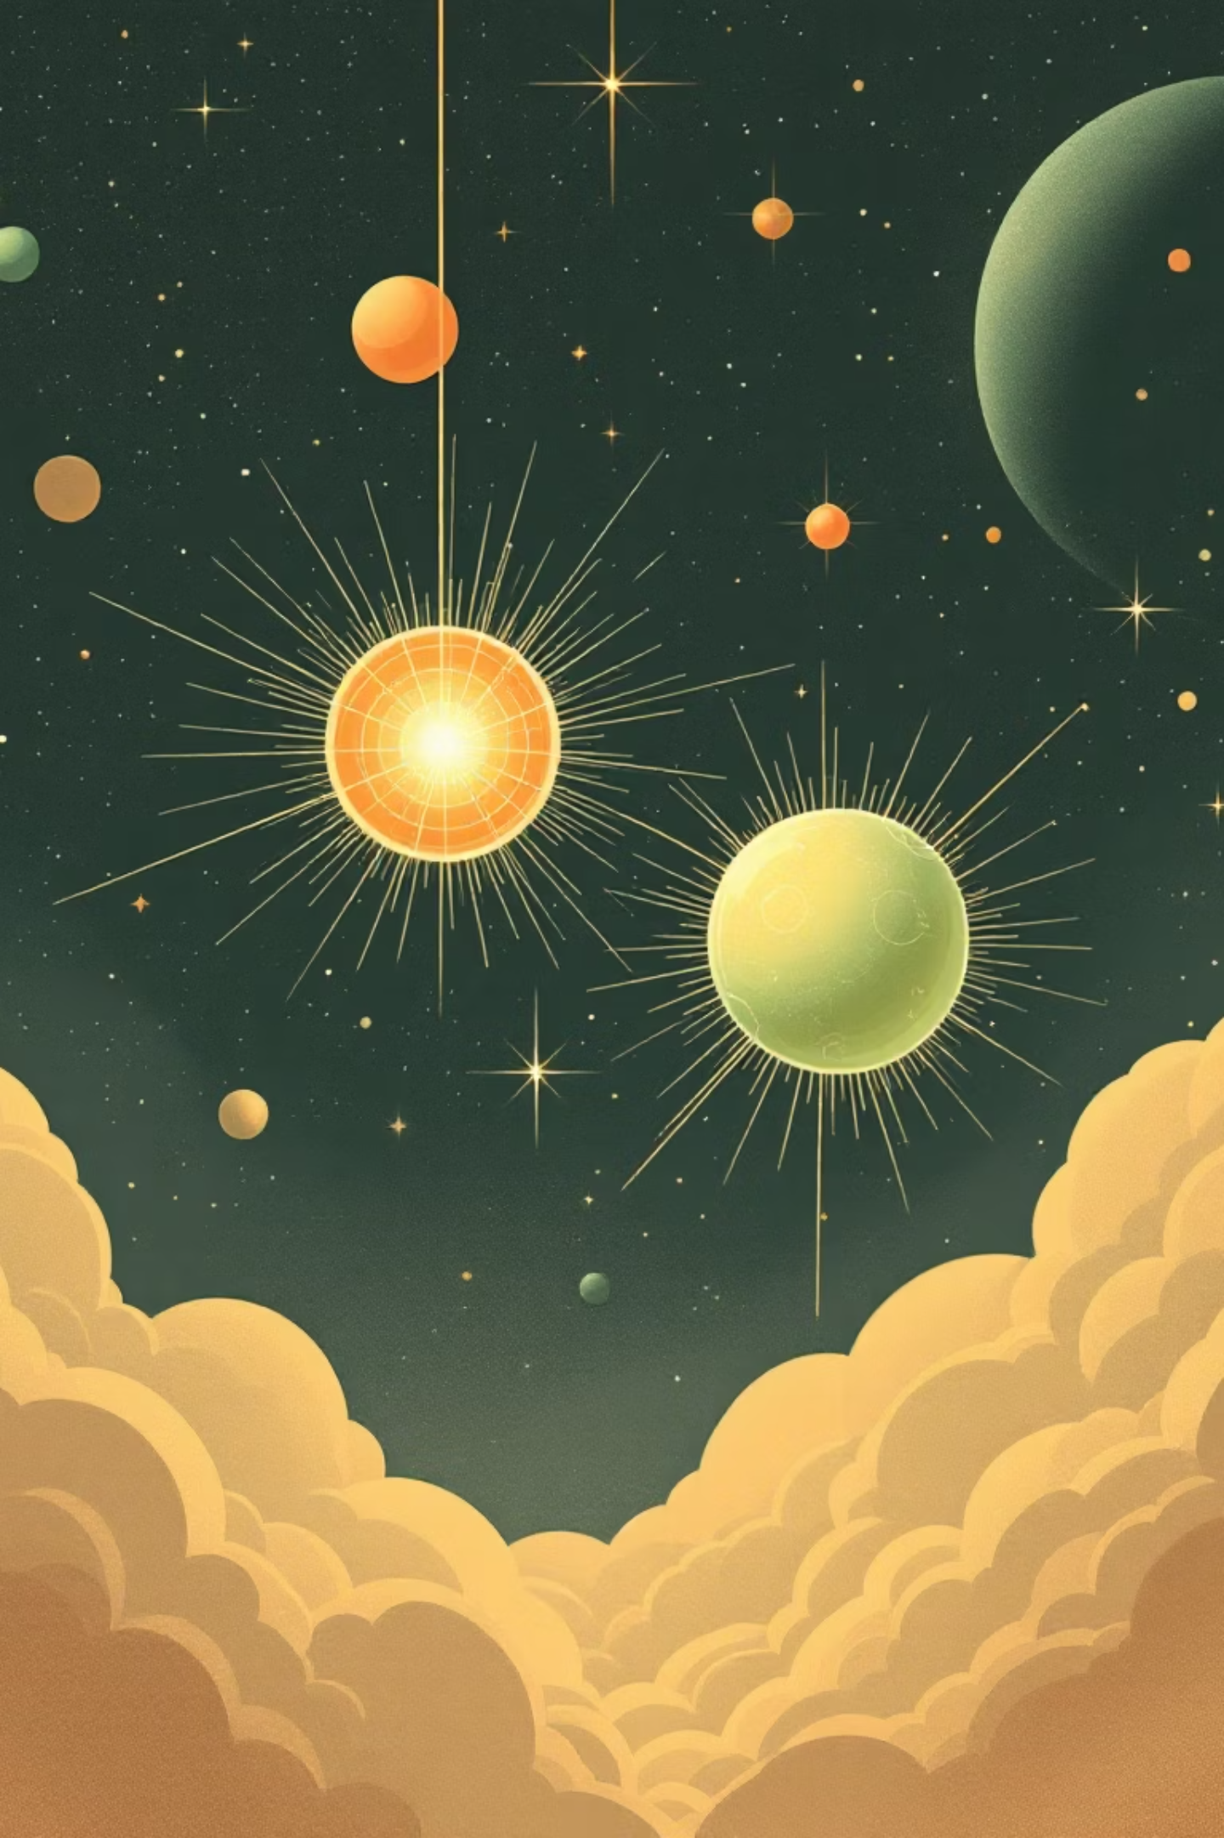
Quantum Entanglement: Spooky Action at a Distance
Einstein called it "spooky action at a distance," and it's one of the strangest phenomena in physics. When two particles become entangled, they form a special connection that defies our everyday understanding of space and distance.
01
02
Create a pair
Separate them
Two particles interact and become quantum-mechanically linked.
Move them to opposite ends of the universe—they stay connected.
03
Measure one
When you measure one particle's state, the other instantly assumes the corresponding state.
This happens faster than the speed of light, which seems impossible! Yet it's real and verified by countless experiments. Scientists are now using entanglement to develop unhackable quantum communication networks and revolutionary quantum computers.

